Slide 1
Unit six APPLICATION OF AUTOMATIC CONTROL
DR (MRS) E. A. ADJEI

Slide 2
Application Of Automatic Control
The purpose of this unit is to demonstrate how to apply all the facts that have been presented so far in designing and analyzing automatic control systems. In many cases, there is more than one method that can be used in this designing and analyzing process. Where possible, we discuss the other methods that can also be used.
Sometimes it’s a good idea to have more than one method available so that one can be used to check the results obtained with the other. And in the designing process, quite often the first design chosen turns out to be the most expensive design; therefore, alternative approaches must be used.

Slide 3
Application Of Automatic Control
So we discuss design examples for various automatic control systems where we can apply our newly acquired knowledge of system designing. We also want to be able to analyze these systems and make forecasts of their behavior resulting from making adjustments to them.
The design approaches presented in these examples have been simplified to keep their developments shortened. However, the overall approaches to the solutions are realistic, and it’s these approaches that should be studied.

Slide 4
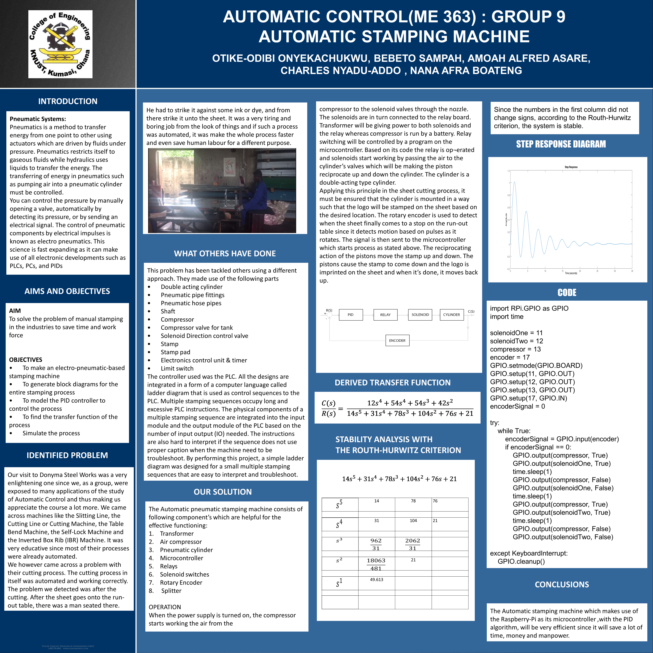
STUDENTS MINI-PROJECTS

Slide 5
